Slide 1
INDIVIDUAL MAJOR PROJECT | MACHINE LEARNING INTERNSHIP
Emotion Recognition in Speech
using MFCC Features and Deep Learning
CNN-BiLSTM-Attention model | RAVDESS | evaluated with Macro F1 on unseen actors
0.531
56.7%
79,080
Presented by Ronia Rosario Sam K
Machine Learning Internship
test Macro F1
test accuracy
parameters
Notes:
Introduce the project: recognise 8 emotions from speech using MFCC features and a CNN-BiLSTM-Attention network. Headline numbers are on unseen test actors.

Slide 2
WHY THIS PROJECT
Problem statement
Develop a machine learning system for emotion recognition in speech using MFCC features and a deep learning model, including data collection, preprocessing, model implementation and evaluation using F1-score.
Why it matters
Why it is hard
Our approach
Call-centre analytics
Tutoring and wellbeing tools
Human-robot interaction
Accessibility support
Emotion is subjective
Every speaker sounds different
Public datasets are small
Models can memorise voices
MFCC + delta features
CNN-BiLSTM-Attention network
Unseen-actor evaluation
Macro F1 as the main metric
Speech Emotion Recognition | MFCC + CNN-BiLSTM-Attention
2
Notes:
Emotion is carried by how we speak (pitch, energy, timbre, rhythm), not only by words. The task: classify a speech clip into one of 8 emotions.

Slide 3
WHAT WE SET OUT TO DO
Objectives
1 Data collection
2 Preprocessing
3 MFCC features
RAVDESS speech corpus, labels parsed from filenames
Resample, trim, normalise, fixed 3 s window, augment (train only)
40 MFCC + delta + delta-delta = 120 features x 130 frames
4 Deep model
5 Baseline
6 F1 evaluation
CNN -> BiLSTM -> attention -> softmax over 8 emotions
RBF-SVM on MFCC statistics for fair comparison
Macro / weighted / per-class F1 on held-out actors
Speech Emotion Recognition | MFCC + CNN-BiLSTM-Attention
3
Notes:
Each objective maps to a module of the code base and is covered by automated tests.

Slide 4
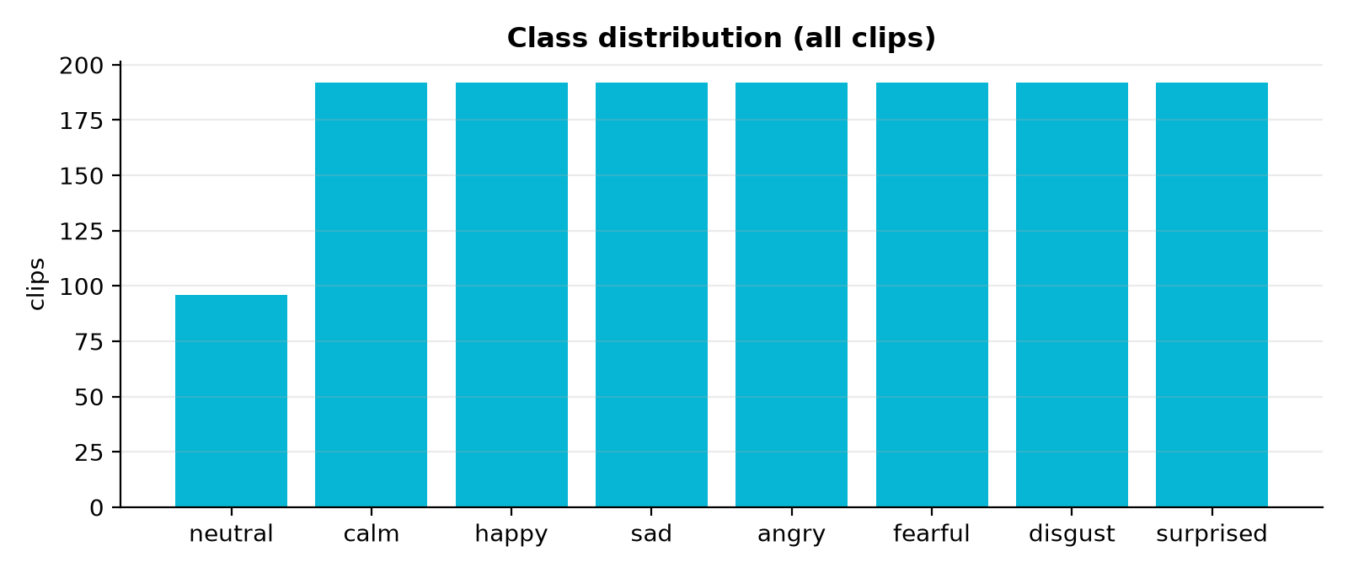
DATA COLLECTION
Dataset: RAVDESS speech
1,440
24
8
clips
actors
emotions
Actor-independent split
Train: 960
Val: 240
Test: 240
Labels: neutral, calm, happy, sad, angry, fearful, disgust, surprised (fixed order used everywhere).
actors 1-16
actors 17-20
actors 21-24
■ No actor appears in two partitions (asserted in code)
■ Training grows to 2,880 samples with augmentation; val/test are never augmented
Speech Emotion Recognition | MFCC + CNN-BiLSTM-Attention
4
Notes:
1,440 clips, 24 actors (12F/12M), 2 sentences, 8 emotions. Neutral has a single intensity, so 96 clips; others have 192. Split is by actor to avoid speaker leakage.

Slide 5
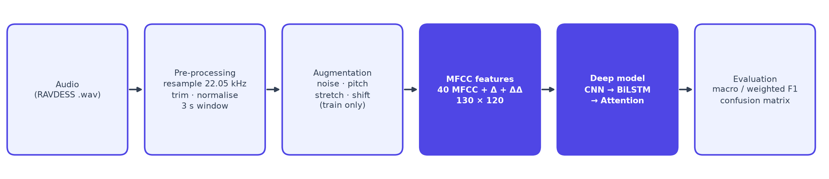
PIPELINE
Proposed methodology
No data leakage
Unseen-actor testing
Validation-based selection
Normalisation statistics come from training data only; augmentation only touches training clips.
Test actors 21-24 never appear in training or tuning, so scores reflect new voices.
Checkpoint, early stopping and final-model choice use validation Macro F1, not the test set.
Speech Emotion Recognition | MFCC + CNN-BiLSTM-Attention
5
Notes:
Raw audio -> preprocessing -> MFCC -> normalisation -> CNN-BiLSTM-Attention -> emotion. Each stage is a tested Python module.

Slide 6
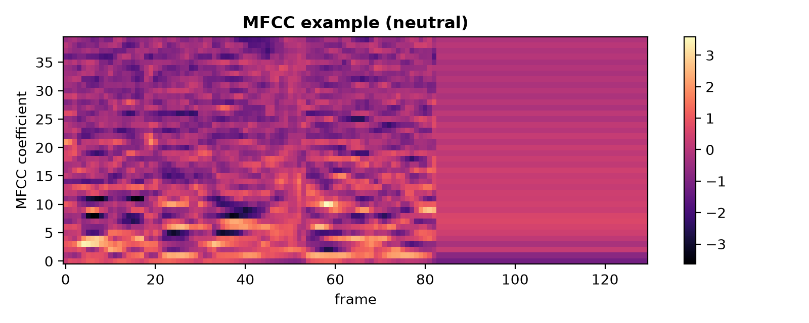
FEATURES
Preprocessing and MFCC extraction
■ Resample to 22,050 Hz mono
■ Trim silence (30 dB) and peak-normalise
■ Fixed window of 3 s (crop / zero-pad)
■ MFCC 40 coefficients, FFT 2048, hop 512, 128 mel bands
■ Delta + delta-delta adds speed and acceleration of each coefficient
■ Tensor 130 frames x 120 features per clip
■ Standardise with training mean / std saved to norm.npz
Augmentation (train only)
2 extra copies per clip: noise, pitch +/-2 semitones, time stretch 0.9-1.1x or time shift.
Speech Emotion Recognition | MFCC + CNN-BiLSTM-Attention
6
Notes:
MFCC describe the voice timbre per frame; delta features add how it changes; delta-delta adds how that change accelerates.

Slide 7
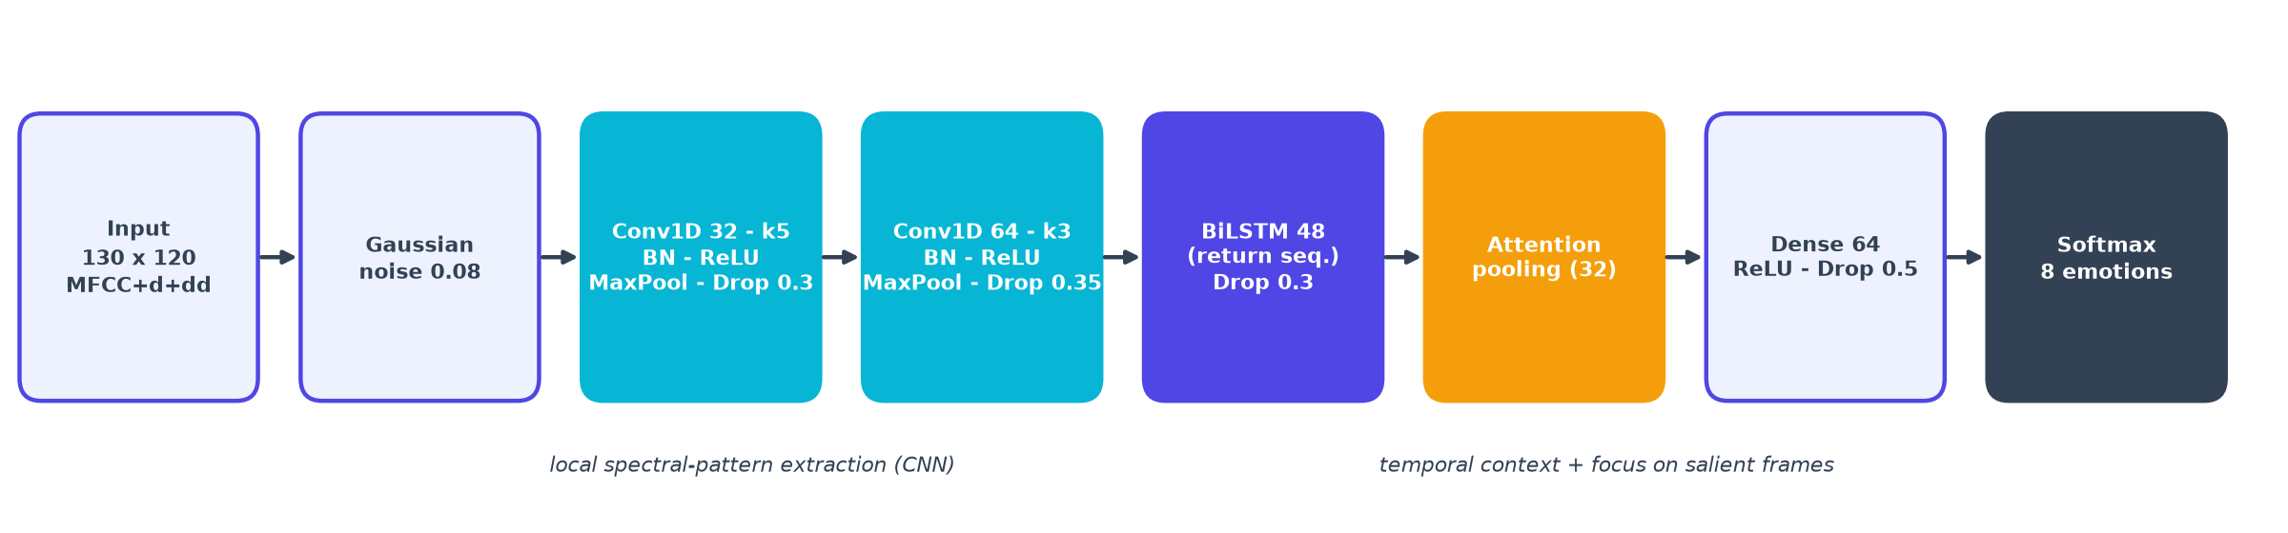
CNN + BILSTM + ATTENTION
Model architecture
CNN
BiLSTM
Attention + softmax
2 Conv1D blocks (32 and 64 filters) with batch norm, ReLU, pooling and dropout.
48 units per direction read the sequence forwards and backwards.
Learned frame weights give one utterance vector; Dense(64) and softmax output 8 probabilities.
Speech Emotion Recognition | MFCC + CNN-BiLSTM-Attention
7
Notes:
Compact network with 79,080 parameters. CNN finds local spectral patterns, BiLSTM models context both ways, attention weights the most informative frames.

Slide 8
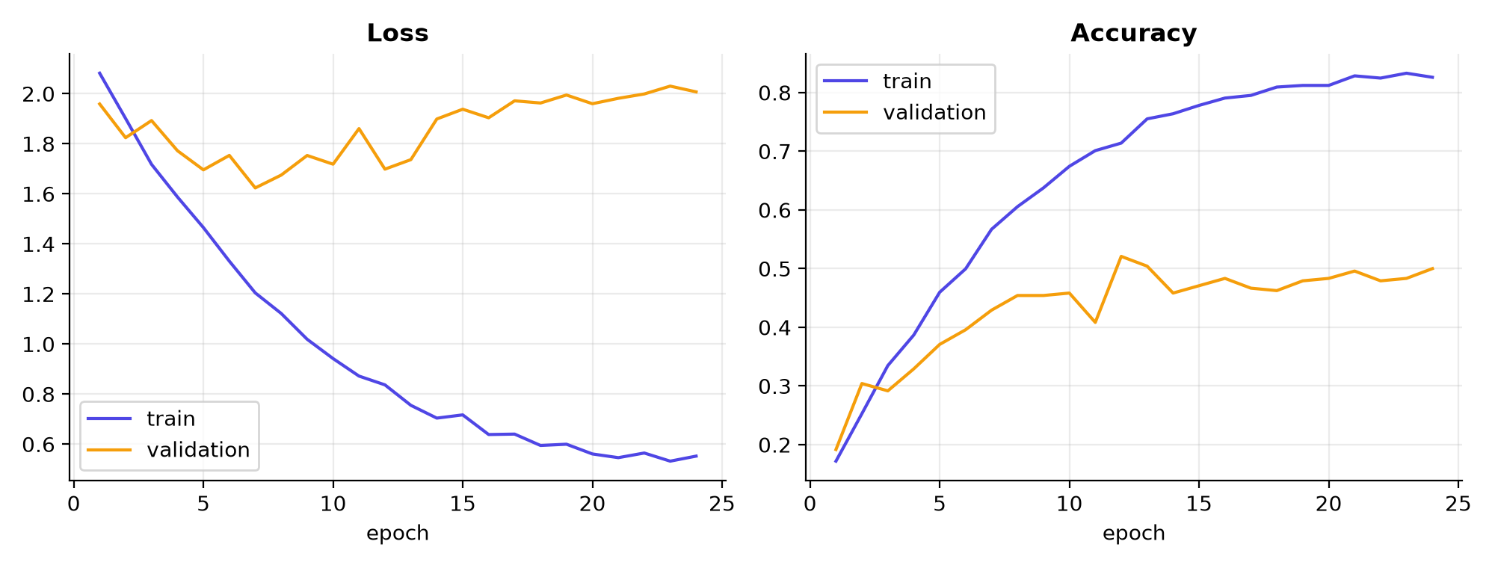
SETUP
Training and evaluation
Optimiser
Adam, lr 1e-3, halved on plateau
Loss
Cross-entropy + class weights
Batch / epochs
32 / up to 60
Early stopping
12 epochs on val Macro F1
Validation loss stops improving after about epoch 12; the checkpoint from the best validation Macro F1 epoch is kept, which limits over-fitting.
Best epoch
12 of 24 run
Seed / time
42 / 170 s CPU
Metrics
Macro F1 (main), weighted F1, per-class, confusion matrix
Speech Emotion Recognition | MFCC + CNN-BiLSTM-Attention
8
Notes:
Class weights compensate for fewer neutral clips. The best checkpoint is the epoch with the highest validation Macro F1.

Slide 9
RESULTS
Results and baseline comparison
0.531
56.7%
Experiment 3 Macro F1
test accuracy
0.446
+0.084
SVM baseline Macro F1
Macro F1 vs SVM
Weighted F1 0.538 | macro precision 0.574 | macro recall 0.574
Small test set: differences of a few points between experiments are not conclusive.
Speech Emotion Recognition | MFCC + CNN-BiLSTM-Attention
9
Notes:
Test set = 4 unseen actors (240 clips). Validation Macro F1 was used to choose the final model. Experiment 4 (stronger dropout) was trained once on the real data and is included in the comparison.

Slide 10
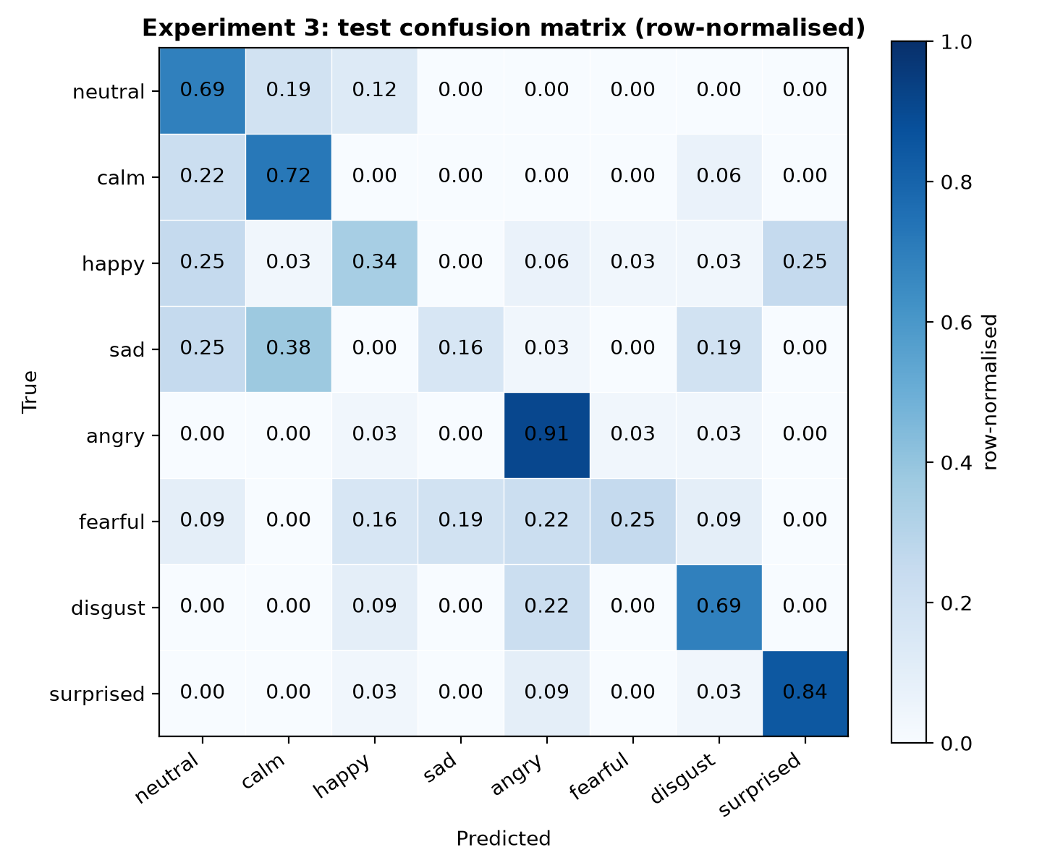
RESULTS
Confusion matrix and error analysis
What the model gets right and wrong
■ Best: surprised (F1 0.806), angry recall 0.906
■ Lowest recall: sad 0.156, fearful 0.250, happy 0.344
■ Neutral over-predicted: precision only 0.297
■ sad -> calm 12 clips (38%)
■ happy -> neutral 8 clips (25%)
■ happy -> surprised 8 clips (25%)
■ sad -> neutral 8 clips (25%)
Possible reasons (untested): similar low-energy delivery in sad / calm / neutral, shared high arousal between fearful / angry / happy, few training actors.
Speech Emotion Recognition | MFCC + CNN-BiLSTM-Attention
10
Notes:
Observed errors (counts from the test confusion matrix). Explanations are hypotheses, not proven.

Slide 11
HONEST ASSESSMENT
Limitations and future work
Limitations
Future work
Small, acted dataset (24 actors, 2 sentences)
Only 4 test actors: noisy estimate
Neutral class has half the clips
Test results were examined during comparisons of Experiments 1-3: test performance may be optimistic
No noise / cross-corpus / fairness tests
Experiment 4 is a single run (one seed)
Repeat Exp 3 vs 4 with several seeds
Actor-grouped cross-validation
SpecAugment, mixup, more corpora (TESS, CREMA-D)
Prosodic features / pre-trained speech encoders
Real-time demo with privacy safeguards
Speech Emotion Recognition | MFCC + CNN-BiLSTM-Attention
11
Notes:
State clearly: acted speech, 4 test actors, one split. The model must not be presented as understanding human emotion in general.

Slide 12
SUMMARY
Conclusion
■ Delivered every requirement: data, preprocessing, MFCC, deep model, F1 evaluation
■ Selected model Experiment 3 (79,080 parameters), chosen by validation Macro F1
■ Test result Macro F1 0.531, accuracy 56.7% on unseen actors
■ Baseline beats the tuned SVM (0.446) by +0.084 Macro F1
■ Honest view uneven across emotions; sad and fearful remain hard
■ Reproducible seeds, tests, one-command evaluation and prediction
Thank you
Questions?
python predict.py clip.wav
python summarize_results.py
Speech Emotion Recognition | MFCC + CNN-BiLSTM-Attention
12
Notes:
Complete pipeline: data -> MFCC -> CNN-BiLSTM-Attention -> F1 evaluation, with tests, inference script and documentation.

